Slide 1
Project Analysis:
Explore Products
By Ankit kumar

Slide 2
Application Overview:
Explore Products is a web application that lets you add and share products from online stores like Amazon, Flipkart and earn money from affiliated links.
You can create an account and add products with details such as name, description, image, and affiliated product link. You can also update or remove your products.
You can generate a URL that showcases all your products and share it with others. They can view and select any product, which will redirect them to the affiliate link i.e Flipkart, Amazon, etc.
Only users who add and share products need to create an account, others can view products with the shared URL without signing in.
Users earn commission from purchases only if they add products with affiliate links from Flipkart or Amazon

Slide 3
Application Tech Stack:
Frontend
Backend
Database
Programming Language:
Java 1.8
Framework:
Spring Boot 2.0.4
Spring Security
Spring Data JPA
Front End:
JSP
HTML, CSS, JS, Bootstrap(3.3.6)
Database:
Oracle 11g
Server:
Apache Tomcat 8.5

Slide 4
Application Architecture:
Presentation Layer | Frontend UI Component | JSP, CSS, JS, HTML
Business Layer | Backend Classes | Java, Spring Boot, Spring Security
Persistence Layer |  | Spring Data JPA
Database Layer |  | Oracle Database
Login Page
Home Page
Product Page
Add Product
Controller
Validator
Service
Security
Model Class
Repository Class
Oracle

Slide 5
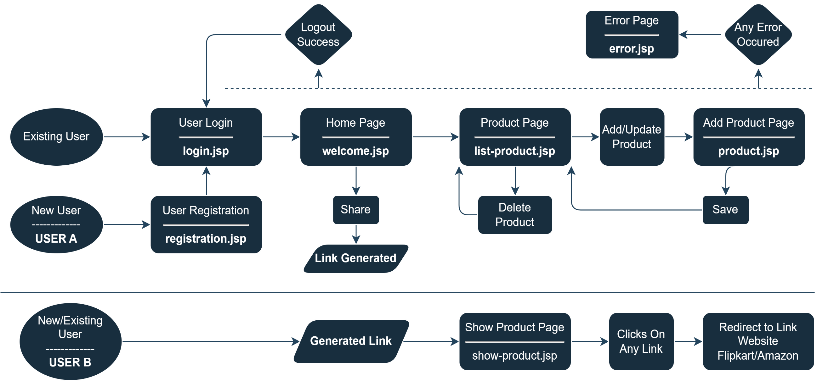
Application Flow:
Any User

Slide 6
Progress report:
Various Application Flows Status(✔️❌〰️)
New user registration ✔️
User registration all field validation ✔️
1. Your name 2. User ID or Email
3. Password 4. Confirm password
User login flow ✔️
1. User ID or Email 2. Password
Home page ✔️
-> Generate share link of products -> Go to Product page ->search product
Share products link generation ✔️
Show products page(Alternate Flow) ✔️
-> Search product

Slide 7
Progress report:
Various Application Flows Status(✔️❌〰️)
Product page(manage products) ✔️
-> Add product -> Update product -> Delete product -> Search product
Add/update product flow ✔️
Add product all field validation ✔️
1. Product Name 2. Description
3. Product Link 4. Product Image
Delete product flow ✔️
Search Product feature(Home, product & show product page) ✔️
All error flow handled 〰️
Logout flow ✔️

Slide 8
thanks

